Slide 1
GOOD DAY!
FELLOW FARMERS OF
EXCELLENT SERVICE!

Slide 2
PARTNERS
in
REVIEW EXAM
PREPARATION

Slide 3
Filipino clerical gen info
Lecture & TEST RATIONALIZATION
Virgo Clemente Lopez, Review Facilitator

Slide 4

Where the dream AND THE DREAMER BECOME ONE

Slide 5
FIRST THINGS FIRST

Slide 6
Let us put ourselves in the Holy Presence of the LORD

Slide 7
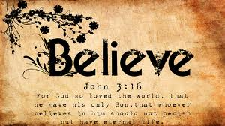

Slide 8
LET’S GET TO KNOW EACH OTHER

Slide 9
Five questions ABOUT ME…

Slide 10
RANDOM
Roll CALL

Slide 11
PROFESSIONAL TAKERS
Where are you?

Slide 12
Sub-prof
Make some NOISE!

Slide 13
Let us specify
Are you READY?

Slide 14
private sector

Slide 15
Government employees

Slide 16
question: what subjects have you finished?

Slide 17
COMMENCEMENT OF LECTURE/ REVIEW

Slide 18
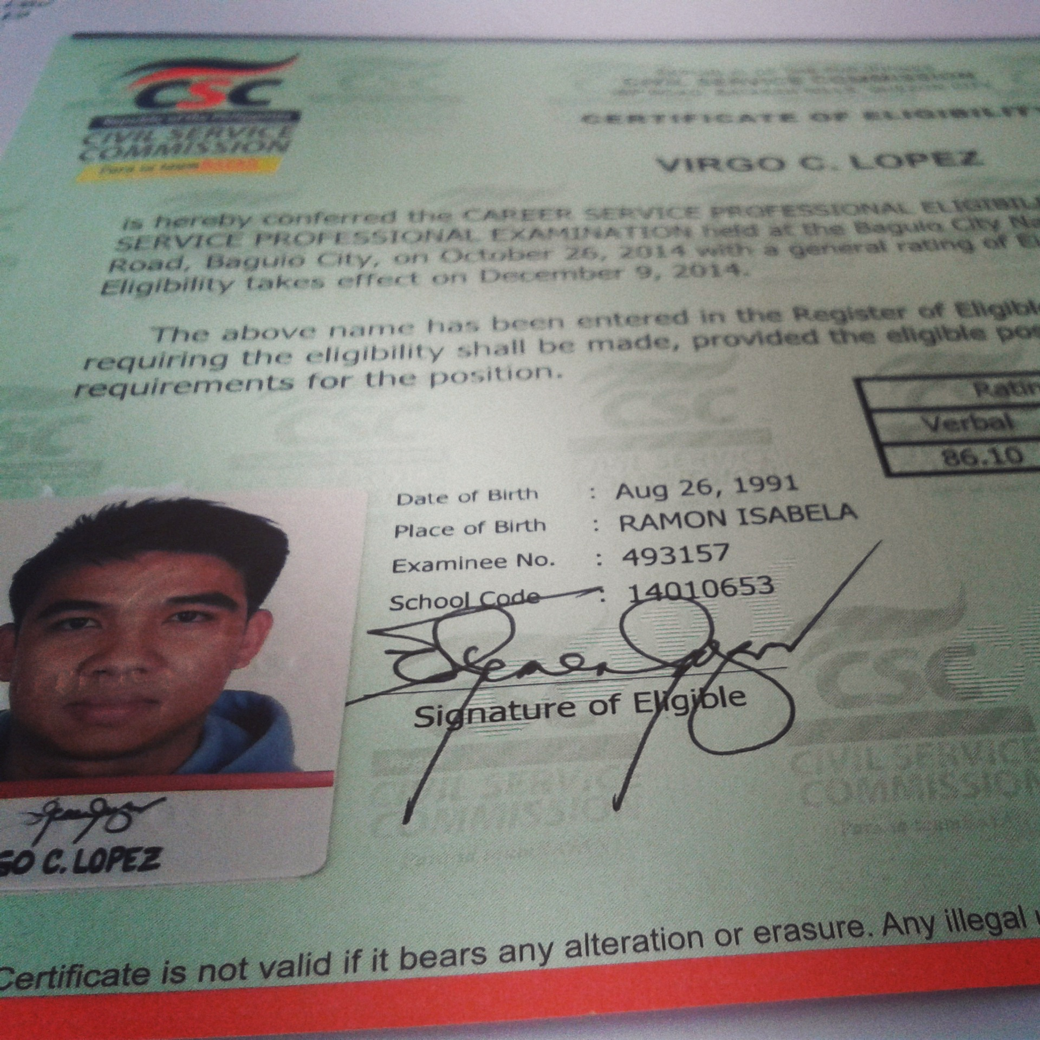
Your ULTIMATE GOAL

Slide 19
OBJECTIVES
UNDERSTAND terms/ meanings and SIGNIFICANCE, CONCEPTS, THEORIES, PRINCIPLES and other PERTINENT IMFORMATION

Slide 20
Clerical operations filipino talasalitaan kawikaan AT PAGWAWASTO TERMS and concepts from the constitution other faqs in cs
ADDENDUM

Slide 21
Let’s get the ball rolling

Slide 22
Ultimate CS drills general questions
A DIAGNOSTIC!

Slide 23
Item 1
__________ supposed to leave early so that _____________ will get there on time.

Slide 24
A. They-they’re
B. Their-they
C. They- they
D. They’re- they

Slide 25
A. They-they’re
B. Their-they
C. They- they
D. They’re- they

Slide 26
Item 2
Which statement would someone refusing to take revenge likely utter?

Slide 27
A. “That is murder.”
B. “Do not take the law into your hands.”
C. “An eye for an eye.”
D. “Justice delayed in justice denied.”

Slide 28
A. “That is murder.”
B. “Do not take the law into your hands.”
C. “An eye for an eye.”
D. “Justice delayed in justice denied.”

Slide 29
Item 3
The Vice-President for Academics gave her secretary an urgent instruction. Which of the following would be the most appropriate response from the secretary?

Slide 30
A. “I’ll take care of that after I’m done with my current task Ma’am.”
B. “How urgent is that Ma’am? I need to know what to prioritize first.”
C. “I’ll act on that immediately Ma’am! You’ll have it on your desk as soon as possible.”
D. “I’ll see what I can do Ma’am.”

Slide 31
A. “I’ll take care of that after I’m done with my current task Ma’am.”
B. “How urgent is that Ma’am? I need to know what to prioritize first.”
C. “I’ll act on that immediately Ma’am! You’ll have it on your desk as soon as possible.”
D. “I’ll see what I can do Ma’am.”

Slide 32
Item 4
After serving the police force for 30 years, he eventually went rogue?

Slide 33
A. The case is inevitable.
B. The case is impossible.
C. The case is lamentable.
D. The case is celebratory.

Slide 34
A. The case is inevitable.
B. The case is impossible.
C. The case is lamentable.
D. The case is celebratory.

Slide 35
Item 5
People have changed their ideas as to the age of our planet.

Slide 36
Passage
A few hundred years ago, many educated people believed the earth was about six thousand years old. Less than one hundred years ago, scientists thought the earth was one hundred million years old. Today scientists have evidence strongly suggests the earth is almost five billion years old?
YOU CAN TELL THAT:

Slide 37
A. The earth seems to be older than people once thought.
B. People now know exactly how old the earth is.
C. The earth seems to be younger than people once thought.
D. People will never have any idea of the earth’s age.

Slide 38
Poem
A few hundred years ago, many educated people believed the earth was about six thousand years old. Less than one hundred years ago, scientists thought the earth was one hundred million years old. Today scientists have evidence strongly suggests the earth is almost five billion years old?
YOU CAN TELL THAT:

Slide 39
A. The earth seems to be older than people once thought.
B. People now know exactly how old the earth is.
C. The earth seems to be younger than people once thought.
D. People will never have any idea of the earth’s age.

Slide 40
Item 6
Banks provide _______ service to customers 24 hours a day via ATMs.

Slide 41
A. convenient
B. crazy
C. cordial
D. controversial

Slide 42
A. convenient
B. crazy
C. cordial
D. controversial

Slide 43
Item 7
Which among the following would suggest ERRATIC behavior?

Slide 44
A. Predictable
B. Normal
C. Inconsistent
D. Stable

Slide 45
A. Predictable
B. Normal
C. Inconsistent
D. Stable

Slide 46
Item 8
Arrange the phrases below to make a correct sentence.

Slide 47
Passage
1. and the department head
2. are representing the school
3. the principal
4. in the stakeholder’s meeting
The order of the phrases to form a sentence is ____________.

Slide 48
A. 4,2,1,3
B. 3,4,2,1
C. 3,1,2,4
D. 4,3,1,2

Slide 49
A. 4,2,1,3
B. 3,4,2,1
C. 3,1,2,4
D. 4,3,1,2

Slide 50
Item 9
Jen and _____ agreed not to attend the meeting.

Slide 51
A. myself
B. herself
C. me
D. I

Slide 52
A. myself
B. herself
C. me
D. I

Slide 53
Item 10
Cases of robberies have tremendously decreased because of SOPHISTICATED security schemes installed in almost all banks in the country. Sophisticated means _______.

Slide 54
A. Primitive
B. High-tech
C. Crude
D. Gauche

Slide 55
Context clues
Cases of robberies have tremendously decreased because of SOPHISTICATED security schemes installed in almost all banks in the country. Sophisticated means _______.

Slide 56
A. Primitive
B. High-tech
C. Crude
D. Gauche

Slide 57
Item 11
Choose the most appropriate statement in resolving a CONFLICT.

Slide 58
A. He led both parties involved to understanding the possible consequences if they won’t come to an amicable settlement.
B. He led both parties to the only options he felt were right.
C. He led both parties to the idea of who was right all along.
D. He led both parties to the advantages and disadvantages of the problem.

Slide 59
A. He led both parties involved to understanding the possible consequences if they won’t come to an amicable settlement.
B. He led both parties to the only options he felt were right.
C. He led both parties to the idea of who was right all along.
D. He led both parties to the advantages and disadvantages of the problem.

Slide 60
A. He led both parties involved to understanding the possible consequences if they won’t come to an amicable settlement.
B. He led both parties to the only options he felt were right.
C. He led both parties to the idea of who was right all along.
D. He led both parties to the advantages and disadvantages of the problem.

Slide 61
Item 12
What is the appropriate responses to the question, "Did you understand the directions?”

Slide 62
A. “I’m getting there.”
B. “It’s all right.”
C. “Thanks, I certainly did.”
D. “I’ll think about it.”

Slide 63
A. “I’m getting there.”
B. “It’s all right.”
C. “Thanks, I certainly did.”
D. “I’ll think about it.”

Slide 64
Item 13
“Speak when you are angry and you will make the best speech you will ever regret.” This is a good advice for those who are ______.

Slide 65
A. submissive
B. ill-tempered and impulsive
C. worrisome
D. agitated

Slide 66
A. submissive
B. ill-tempered and impulsive
C. worrisome
D. agitated

Slide 67
Item 14
During seminars or lecture forums you should clarify what you didn’t understand by:

Slide 68
A. asking the person seated next to you
B. raising your hands to call the attention of the speaker/lecturer
C. waiting for the open forum to politely ask questions
D. taking note of the particular item and surfing it on the web

Slide 69
A. asking the person seated next to you
B. raising your hands to call the attention of the speaker/lecturer
C. waiting for the open forum to politely ask questions
D. taking note of the particular item and surfing it on the web

Slide 70
A. asking the person seated next to you
B. raising your hands to call the attention of the speaker/lecturer
C. waiting for the open forum to politely ask questions
D. taking note of the particular item and surfing it on the web

Slide 71
Item 15
Form a sentence from these words.

Slide 72
Words
1. the senator
2. although he raised his voice
3. as a legislator
4. accepted several amendment
Which is the BEST arrangement?

Slide 73
A. 2,1,4,3
B. 1,2,3,4
C. 4,3,2,1
D. 2,1,3,4

Slide 74
A. 2,1,4,3
B. 1,2,3,4
C. 4,3,2,1
D. 2,1,3,4

Slide 75
Item 16
“I die just when the dawn breaks to herald the day.” Who said this?

Slide 76
A. Jose Rizal
B. Jose Laurel
C. Manuel Quezon
D. Benigno Aquino Jr.

Slide 77
A. Jose Rizal
B. Jose Laurel
C. Manuel Quezon
D. Benigno Aquino Jr.

Slide 78
Item 17
I should have returned the books to the library last Monday. They are now three days ____.

Slide 79
A. Deferred
B. Delayed
C. Past the deadline
D. Overdue

Slide 80
A. Deferred
B. Delayed
C. Past the deadline
D. Overdue

Slide 81
Item 18
How can the following be interpreted?
“ I value a man for the size of his heart.”

Slide 82
A. Man will die without a big heart.
B. Man’s kindness is most important.
C. Man’s worth is measured size by size of his heart.
D. Man’s lifespan depends on the size of his heart.

Slide 83
Do not INTERPRET LITERALLY!
A. Man will die without a big heart.
B. Man’s kindness is most important.
C. Man’s worth is measured size by size of his heart.
D. Man’s lifespan depends on the size of his heart.

Slide 84
Item 20
If she ________ President, she would live in Malacanang.

Slide 85
A. was
B. were
C. am
D. would be

Slide 86
A. was
B. were
C. am
D. would be

Slide 87
Item 21
What is the theme of the following quote?

Slide 88
QOUTE
“Nothing that happens in this world ever happens by chance; it is all part of a grand design.”

Slide 89
A. Destiny
B. Ambition
C. Dream
D. Luck

Slide 90
A. Destiny
B. Ambition
C. Dream
D. Luck

Slide 91
Item 22
The event’s plenary speaker was loquacious. What is the meaning of the underlined word?

Slide 92
A. reticent
B. verbose
C. reserved
D. taciturn

Slide 93
LOQUACIOUS TALKATIVE

Slide 94
Reticent, reserved, TACITURN Being quiet

Slide 95
A. reticent
B. verbose
C. reserved
D. taciturn

Slide 96
Item 23
Which phrase is associated with President Ramon Magsaysay?

Slide 97
A. For whom the bell tolls
B. To whom it may concern
C. For democracy will die
D. To all the girls I have loved before

Slide 98
A. For whom the bell tolls
B. To whom it may concern
C. For democracy will die
D. To all the girls I have loved before

Slide 99
PART OF THE LYRICS OF THE POLITICAL JINGLE MAMBO MAGSAYSAY

Slide 100
Item 24
What is the theme of the following quote? “Have a good bank account, a good cook and a good digestion.”

Slide 101
A. Preoccupation
B. Security
C. Goodness
D. Responsibility

Slide 102
A. Preoccupation
B. Security
C. Goodness
D. Responsibility

Slide 103
Good bank account- financial security good cook- emotional security good digestion- health-wise security

Slide 104
Item 25
She described her classmate’s statement as too SOPHOMORIC. This means __________.

Slide 105
A. Wise
B. Grown up
C. Mature
D. Immature

Slide 106
A. Wise
B. Grown up
C. Mature
D. Immature

Slide 107
Item 26
What message is being conveyed by the following? “Stop shilly shallying and make up your mind.”

Slide 108
A. Decide
B. Go on
C. Hesitate
D. Move forward

Slide 109
A. Decide
B. Go on
C. Hesitate
D. Move forward

Slide 110
Item 27
Jeyro _________ his project on time.

Slide 111
A. past
B. passed
C. fast
D. pass

Slide 112
A. past
B. passed
C. fast
D. pass

Slide 113
Item 28
There should be CESSATION of inequality in the world.

Slide 114
A. stop
B. continuity
C. patronage
D. movement

Slide 115
A. stop
B. continuity
C. patronage
D. movement

Slide 116
Item 29
The principal claims she was kept in the dark in the situation the school is facing. What does the statement mean?

Slide 117
A. She understood the situation.
B. She cannot understand the situation.
C. She doesn’t know the situation.
D. She failed to understand the situation.

Slide 118
A. She understood the situation.
B. She cannot understand the situation.
C. She doesn’t know the situation.
D. She failed to understand the situation.

Slide 119
Item 30
Before the competition, the coach told his team to bring home the bacon.

Slide 120
A. The team has to go to the market.
B. The team has to compete with enthusiasm.
C. The team has to win in the competition.
D. The team has to cheat in the competition.

Slide 121
A. The team has to go to the market.
B. The team has to compete with enthusiasm.
C. The team has to win in the competition.
D. The team has to cheat in the competition.

Slide 122
Item 31
What you said does not hold water with me. What does the statement mean?

Slide 123
A. Unbelievable
B. Understandable
C. Believable
D. Unimportant

Slide 124
A. Unbelievable
B. Understandable
C. Believable
D. Unimportant

Slide 125
Item 32
It was an overrated show, sighed Paks.

Slide 126
A. The show was not good.
B. The show was not appreciated.
C. The show was not understood.
D. The show was not educational.

Slide 127
A. The show was not good.
B. The show was not appreciated.
C. The show was not understood.
D. The show was not educational.

Slide 128
Item 33
The examination will take place a quarter after five. Aldrich should be in the venue at _____.

Slide 129
A. 4:45 PM
B. 5:55 PM
C. 5:15 PM
D. 5:35 PM

Slide 130
A. 4:45 PM
B. 5:55 PM
C. 5:15 PM
D. 5:35 PM

Slide 131
Item 34
I don’t like SONOROUS sounds, I prefer music that is pleasing to the ears.

Slide 132
A. loud
B. calm
C. quiet
D. soft

Slide 133
A. loud
B. calm
C. quiet
D. soft

Slide 134
Item 35
Peter and Thomas are discussing the current economic situation. The former believes everything will be solved immediately. The latter believes otherwise. The former refers to _______.

Slide 135
A. Thomas
B. Peter
C. both of them
D. none of them

Slide 136
A. Thomas
B. Peter
C. both of them
D. none of them

Slide 137
How many points did you get correctly?

Slide 138
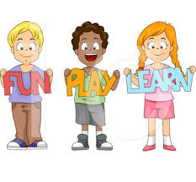

Slide 139
BENG (B) SNAP (S) CLAP (C) BE-BENG (B-B)
GET THE BALL ROLLING

Slide 140
B S C B-B S C S B S C B-B S C S
TRY THIS

Slide 141
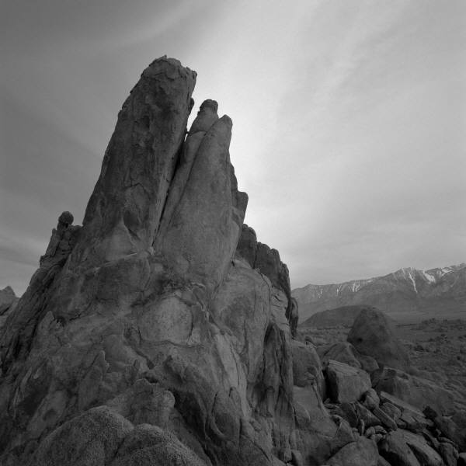
Be a global teacher
LEARN ENGLISH!

Slide 142
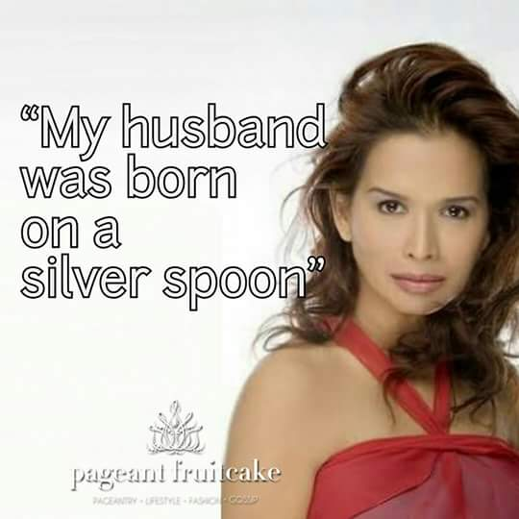

Slide 143
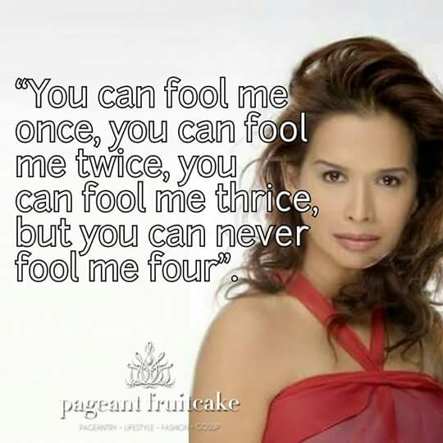

Slide 144
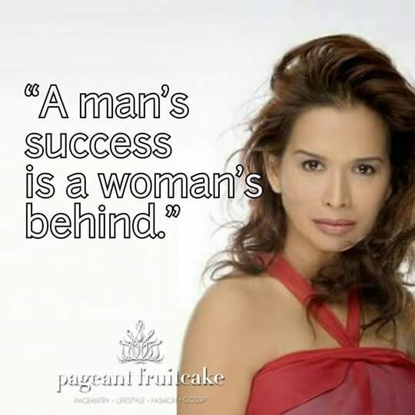

Slide 145
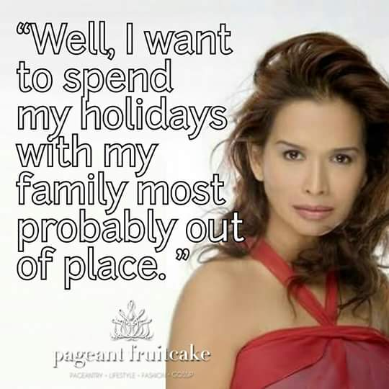

Slide 146
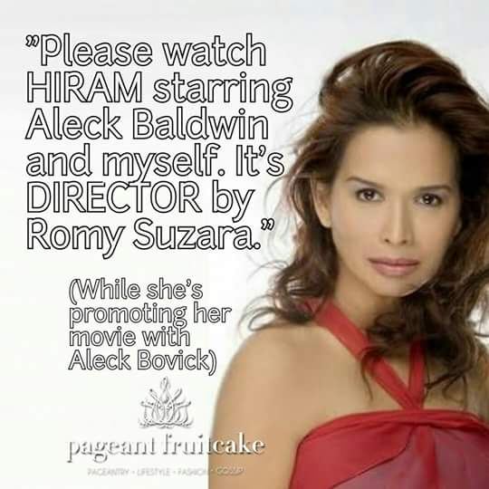

Slide 147
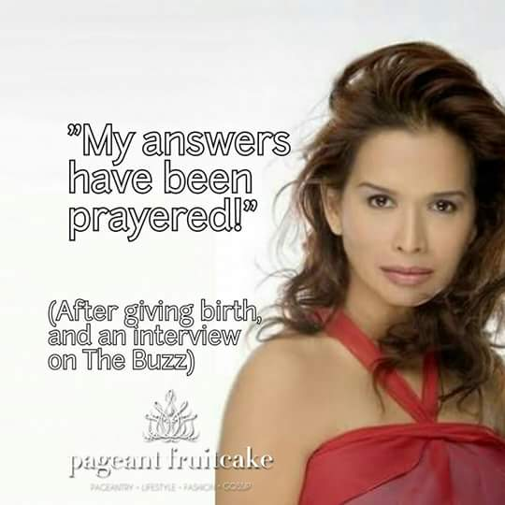

Slide 148
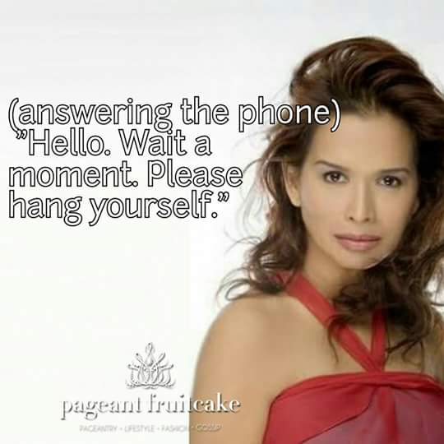

Slide 149
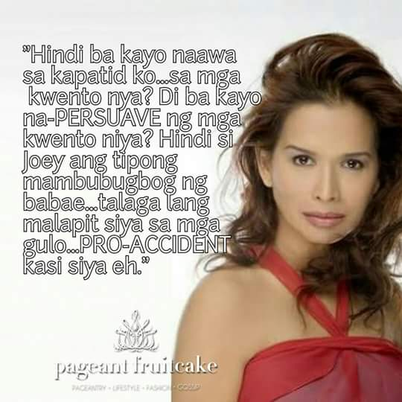

Slide 150
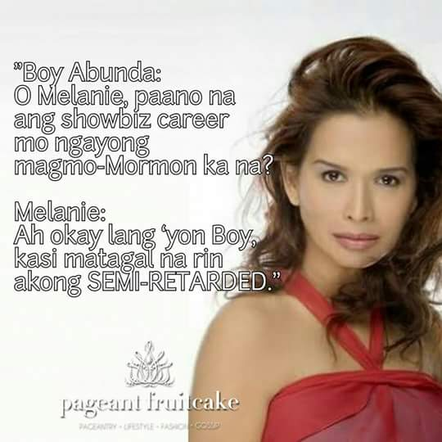

Slide 151


Slide 152
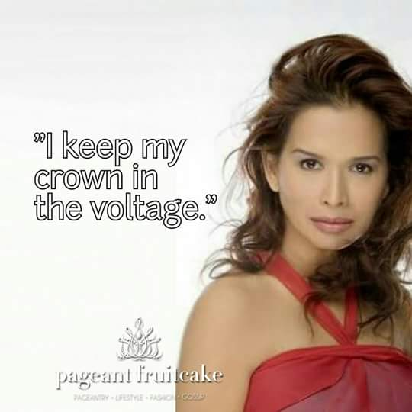

Slide 153


Slide 154
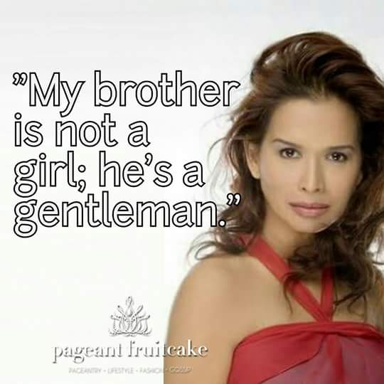

Slide 155


Slide 157
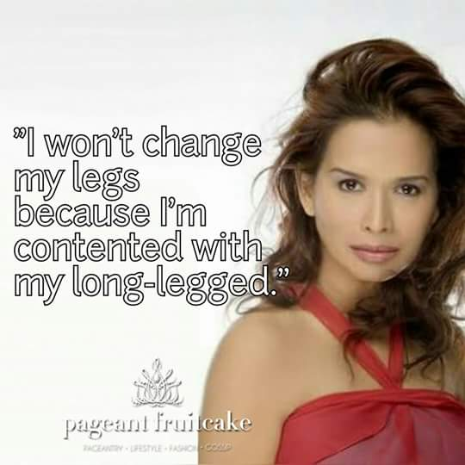

Slide 158


Slide 159
Things you must know in english
LET US START!

Slide 160
PARTS OF SPEECH
8 PARTS OF SPEECH.pptx

Slide 161
VERB TENSE
12 VERB TENSES.pptx

Slide 162
PRONOUN-ANTECEDENT
13 PRONOUN-ANTECEDENT AGREEMENT.ppt

Slide 163
EXERCISE ON PRONOUN-ANTECEDENT
14 PRONOUN-ANTECEDENT QUIZ.ppt

Slide 164
CONJUNCTIONS and PREPOSITIONS
15 KINDS OF CONJUNCTIONS and PREPOSITIONS.pptx

Slide 165
PUNCTUATION MARKS and their USES
19 WRITING punctuation marks.pptx

Slide 166
SVA
10 SUBJECT-VERB AGREEMENT SIMPLIFIED.pptx

Slide 167
MISPLACED and DANGLING MODIFIERS
21 MISPLACED AND DANGLING MODIFIERS.ppt

Slide 168
Let us try this!
7 GRAMMATICAL ERRORS.pptx

Slide 169
Here is MORE
24 GRAMMAR EXECISES.pptx

Slide 170
WHICH IS WHICH?
17 WORDS OFTEN CONFUSED.pptx

Slide 171
WORDS OVERLOAD
16 vocabulary terms.pptx

Slide 172
VOCABULARY ON THE GO
VOCABULARY TERMS.pptx

Slide 173
GENERAL INFO TO KNOW
GENERAL ENGLISH.pptx

Slide 174
CHECK-UP
20 IELTS SPELLING.pptx

Slide 175
LITERATURE
LITERATURE CONCEPTS.pptx

Slide 176
Remember thOSE…

Slide 177
Post-test

Slide 178
Item 1
Determine which may be the best order in which the sentences should be arranged to result in a well organized paragraph. Encircle the letter of the correct answer.

Slide 179
Item 1
A. Now, we shall do everything we can to enforce this law.
B. In the struggle against crime, government and people should join hands.
C. Republic Act 7659, the death penalty law is government’s response against cruelty and heartlessness.
D. The law’s main objective is not retribution but reform and rehabilitation of offenders and would-be offenders.
E. All countries in the world are presently siege by violent crime.
a. CEBAD b. EBCDA c. CEDAB d. ACEBD e. CBEDA

Slide 180
Item 2 and 3
If there is an error, choose the letter of the underlined part that must be changed to make the sentence correct. If there is no error, choose letter E.

Slide 181
Item 2
The recent establishment of “Crime Busters” officially
A
sanctioned neighborhood block watching groups, has
B
dramatic improved relations between citizens and police.
C D
No error
E

Slide 182
Item 3
The effort to create appropriate theatrical effects often
A B
result in settings that cannot
be effective without an imaginative lighting crew. No error
C D E

Slide 183
Item 4
The doctor recommended eating healthier meals and _______________.
a. to do exercise c. exercise
b. doing exercise d. to exercise

Slide 184
Item 5
These patients are facing _______ death.
A. eminent C. imminent
B. Eminence D. Imminence

Slide 185
Item 6
There are times when we are forced to do things against our own volitions. The underlined word means:
a. opinion
b. intuition
c. will
d. Fate

Slide 186
Item 7
William Shakespeare showed composure in front of his critics amidst countless derision. The underlined word means:
a. agitation
b. fear
c. aplomb
d. Nervousness

Slide 187
Time to find out the aswers

Slide 188
Item 1
A. Now, we shall do everything we can to enforce this law.
B. In the struggle against crime, government and people should join hands.
C. Republic Act 7659, the death penalty law is government’s response against cruelty and heartlessness.
D. The law’s main objective is not retribution but reform and rehabilitation of offenders and would-be offenders.
E. All countries in the world are presently siege by violent crime.
a. CEBAD b. EBCDA c. CEDAB d. ACEBD e. CBEDA

Slide 189
Item 1
A. Now, we shall do everything we can to enforce this law.
B. In the struggle against crime, government and people should join hands.
C. Republic Act 7659, the death penalty law is government’s response against cruelty and heartlessness.
D. The law’s main objective is not retribution but reform and rehabilitation of offenders and would-be offenders.
E. All countries in the world are presently siege by violent crime.
a. CEBAD b. EBCDA c. CEDAB d. ACEBD e. CBEDA

Slide 190
A. Now, we shall do everything we can to enforce this law.
B. In the struggle against crime, government and people should join hands.
C. Republic Act 7659, the death penalty law is government’s response against cruelty and heartlessness.
D. The law’s main objective is not retribution but reform and rehabilitation of offenders and would-be offenders.
E. All countries in the world are presently siege by violent crime.
a. CEBAD b. EBCDA c. CEDAB d. ACEBD e. CBEDA

Slide 191
Item 2
The recent establishment of “Crime Busters” officially
A
sanctioned neighborhood block watching groups, has
B
dramatic improved relations between citizens and police.
C D
No error
E

Slide 192
Item 2
The recent establishment of “Crime Busters” officially
A
sanctioned neighborhood block watching groups, has
B
dramatic improved relations between citizens and police.
C D
No error
E

Slide 193
Item 3
The effort to create appropriate theatrical effects often
A B
result in settings that cannot
be effective without an imaginative lighting crew. No error
C D E

Slide 194
Item 3
The effort to create appropriate theatrical effects often
A B
result in settings that cannot
be effective without an imaginative lighting crew. No error
C D E

Slide 195
Item 4
The doctor recommended eating healthier meals and _______________.
a. to do exercise c. exercise
b. doing exercise d. to exercise

Slide 196
Item 4
The doctor recommended eating healthier meals and _______________.
a. to do exercise c. exercise
b. doing exercise d. to exercise

Slide 197
Item 5
These patients are facing _______ death.
A. eminent C. imminent
B. Eminence D. Imminence

Slide 198
Item 5
These patients are facing _______ death.
A. eminent C. imminent
B. Eminence D. Imminence

Slide 199
Item 6
There are times when we are forced to do things against our own volitions. The underlined word means:
a. opinion
b. intuition
c. will
d. Fate

Slide 200
Item 6
There are times when we are forced to do things against our own volitions. The underlined word means:
a. opinion
b. intuition
c. will
d. Fate

Slide 201
Item 7
William Shakespeare showed composure in front of his critics amidst countless derision. The underlined word means:
a. agitation
b. fear
c. aplomb
d. Nervousness

Slide 202
Item 7
William Shakespeare showed composure in front of his critics amidst countless derision. The underlined word means:
a. agitation
b. fear
c. aplomb
d. Nervousness

Slide 203
We are almost done!
FINALLY!

Slide 204
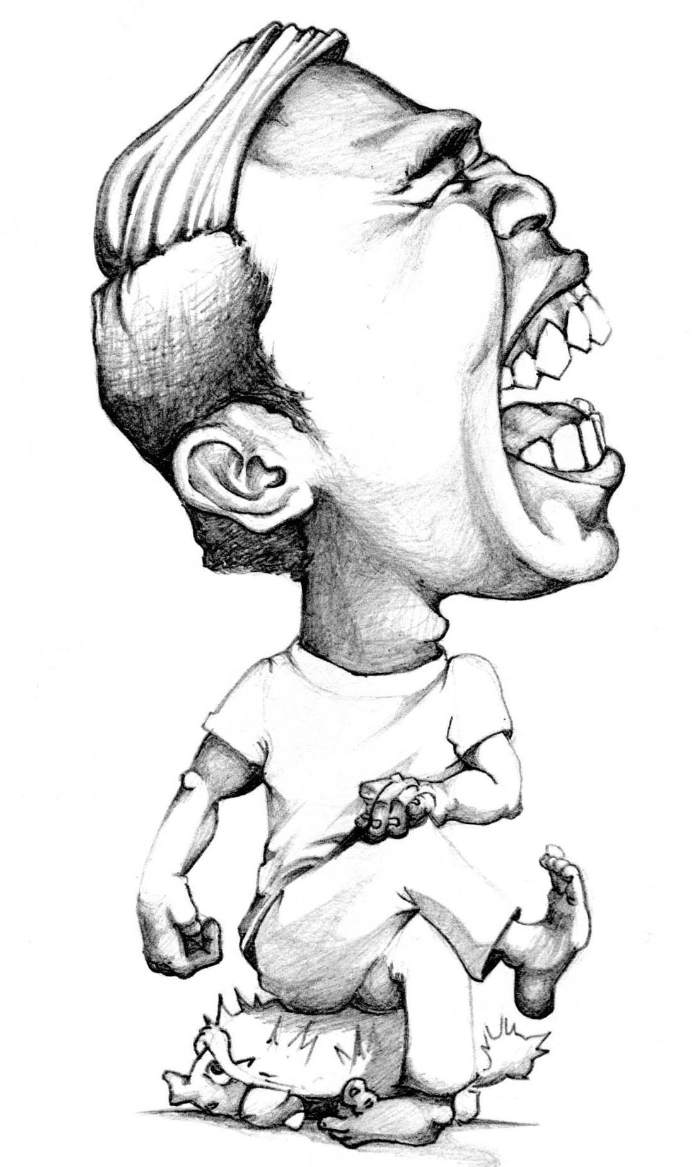
We’re DONE!

Slide 205


Slide 206


Slide 207


Slide 208
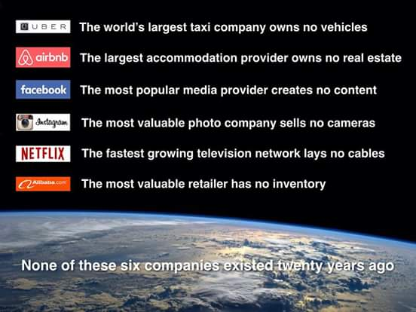

Slide 209


Slide 210


Slide 211


Slide 212
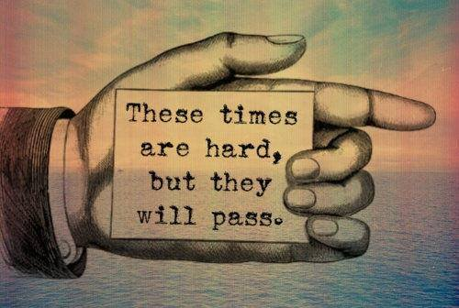
HOWEVER, PLEASE BE REMINDED!

Slide 213
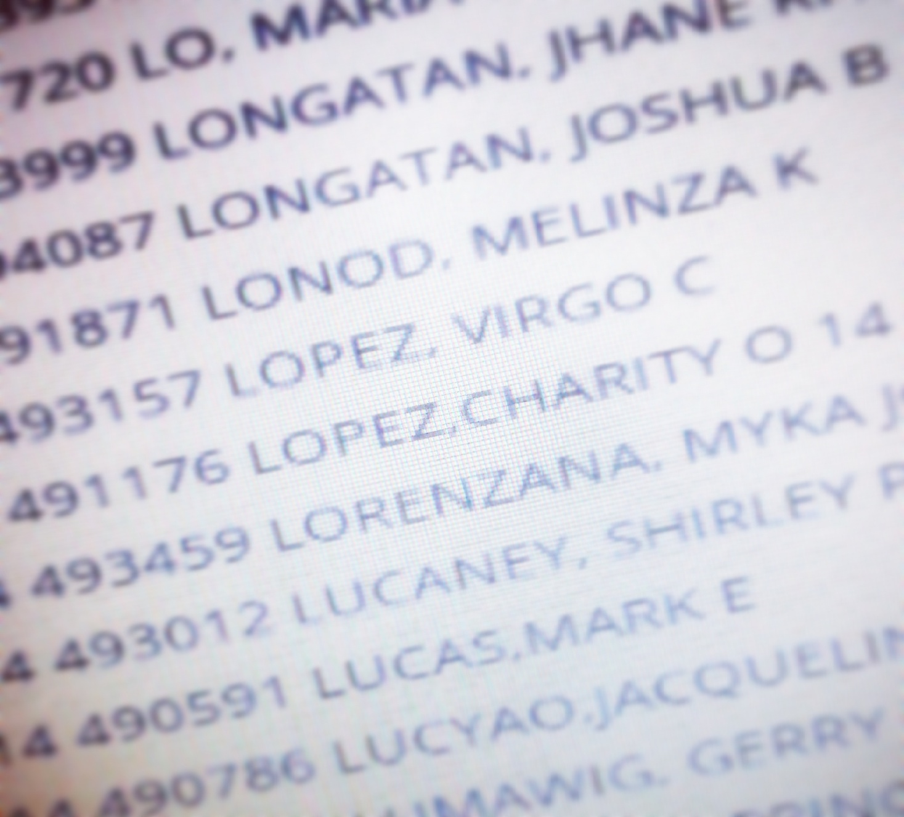
HOPE TO SEE YOUR NAME!

Slide 214
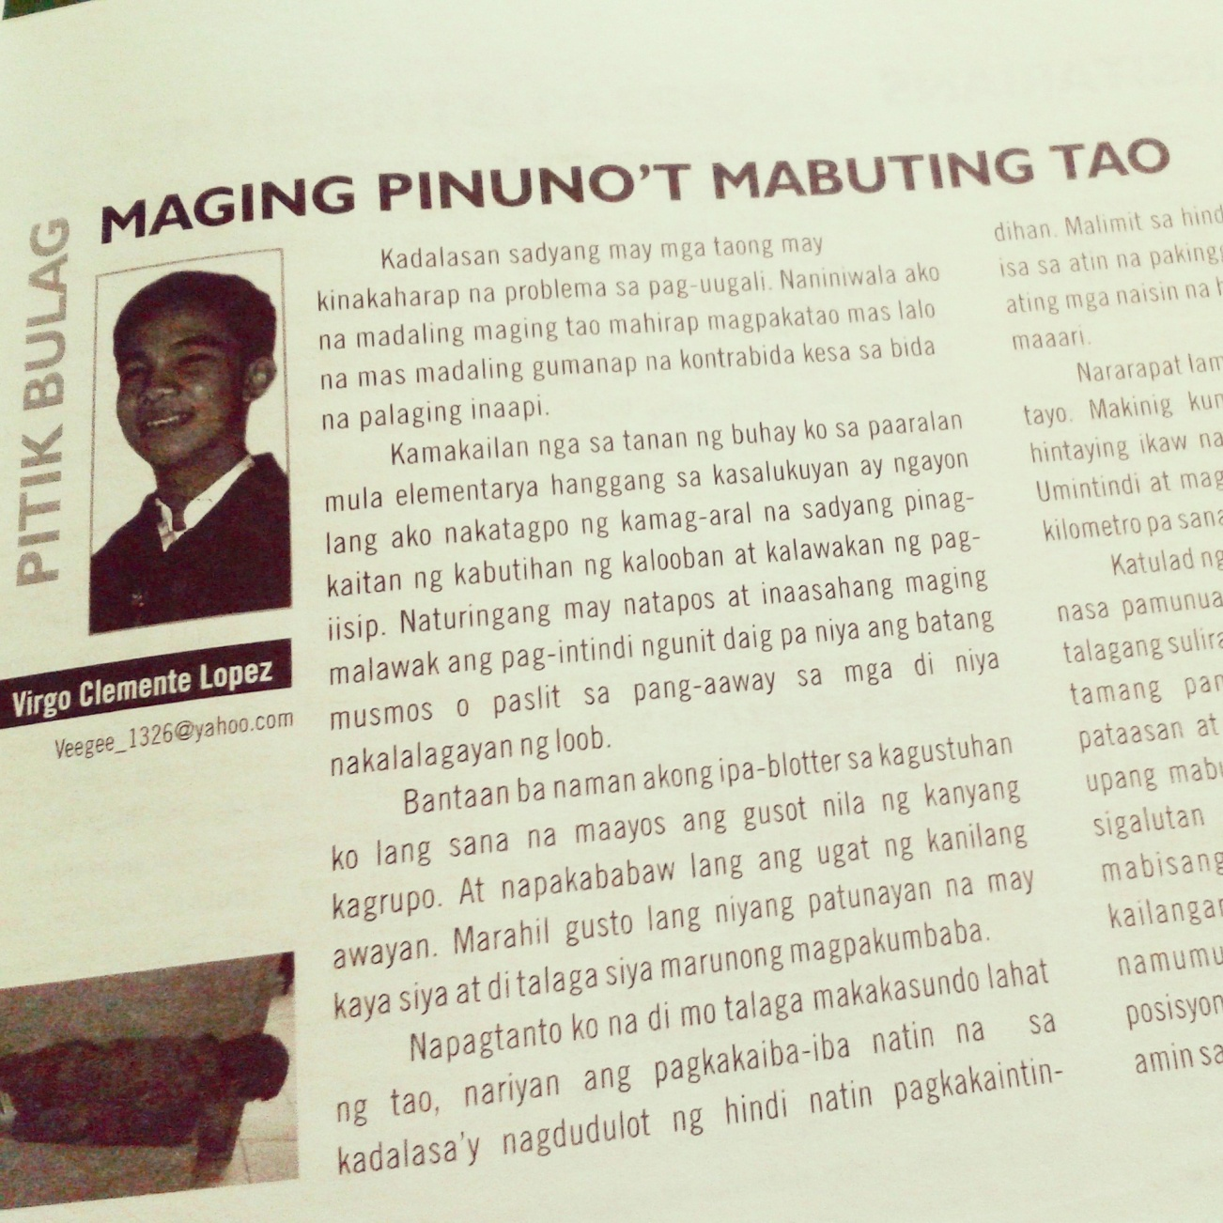
And when you become ONE, PLEASE…

Slide 215
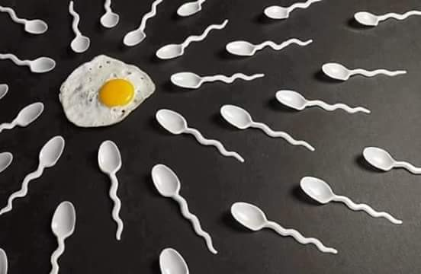
Let us PONDER….

Slide 216
THE great need in the GOVERNMENT is not for more genius or even for more skill, but it is for aspiring mentors willing to accept responsibility for what they do.
Remember this!

Slide 217
CONGRATULATIONS IN ADVANCE!
Claim it!

Slide 218
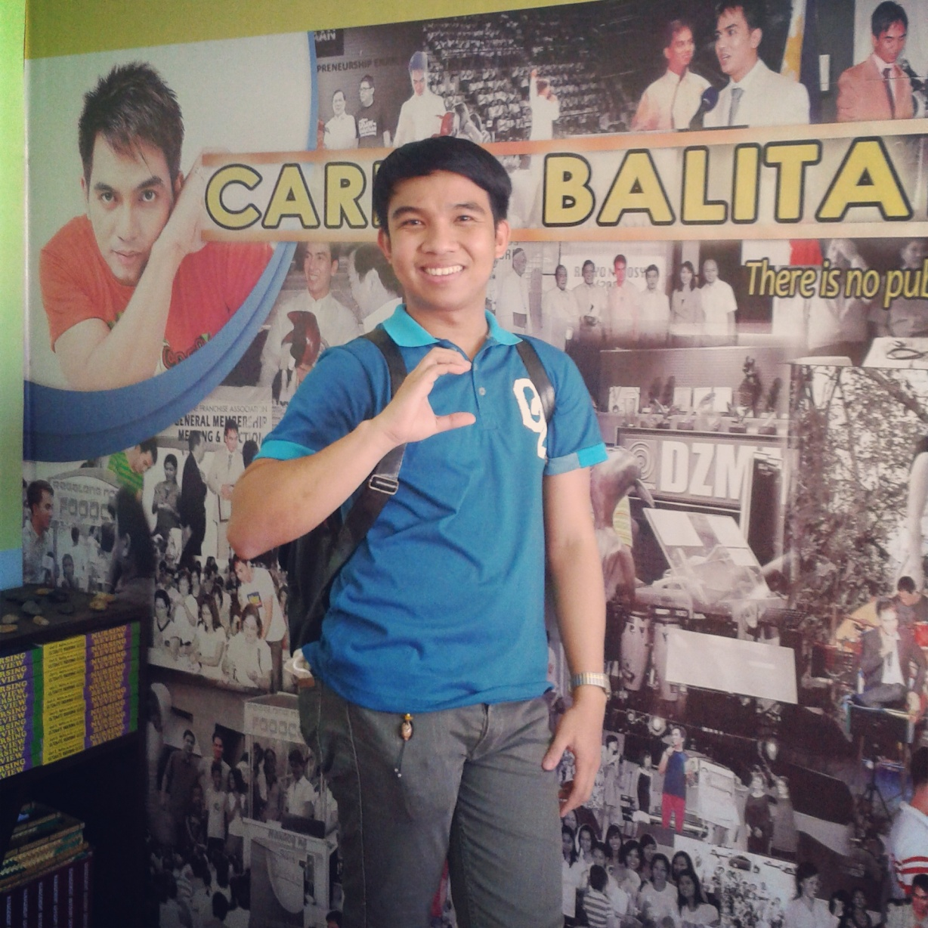
GOD BLESS YOU all!
Thank you
BEAUTIFUL SOULS!

Slide 219
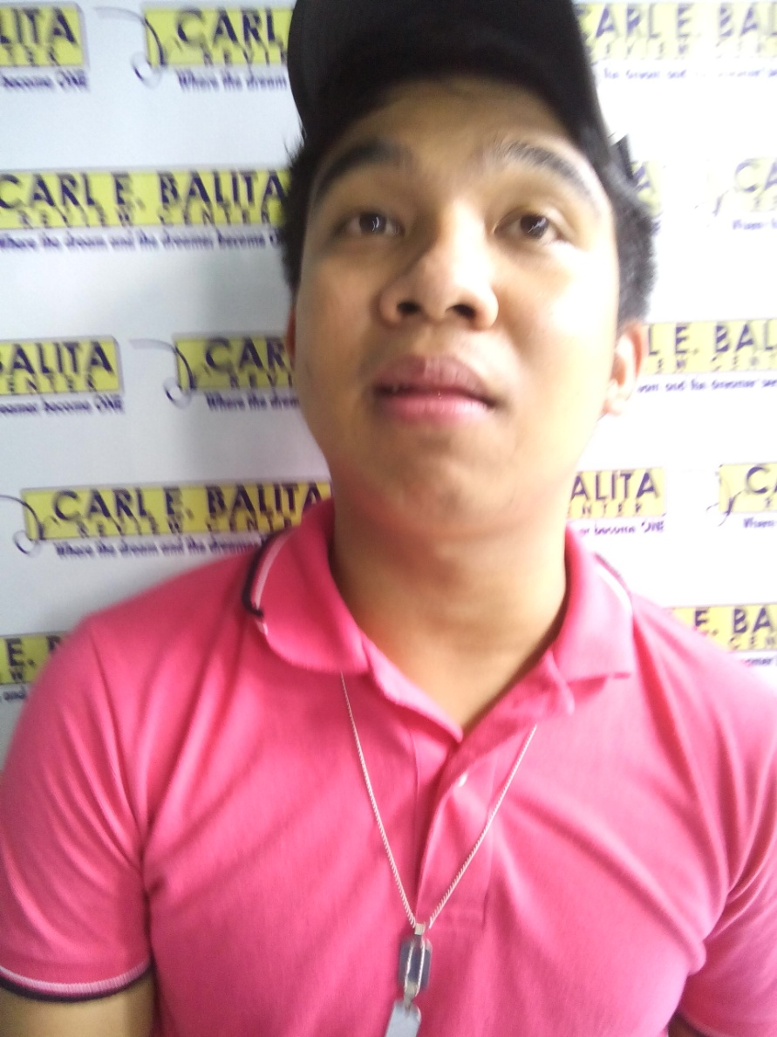
Remember ME (NOT) this WAY!

Slide 220
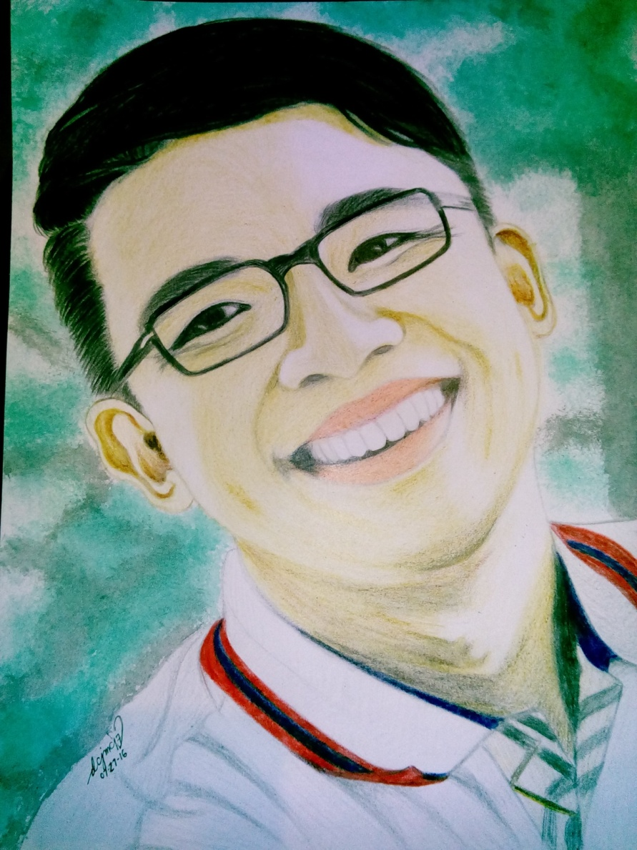
BUT Remember ME this WAY!

Slide 221
For OFFICIAL BUSINESS ONLY
09128439440/
veegee_1326@yahoo.com

Slide 222

Thank YOU!

